Slide 1
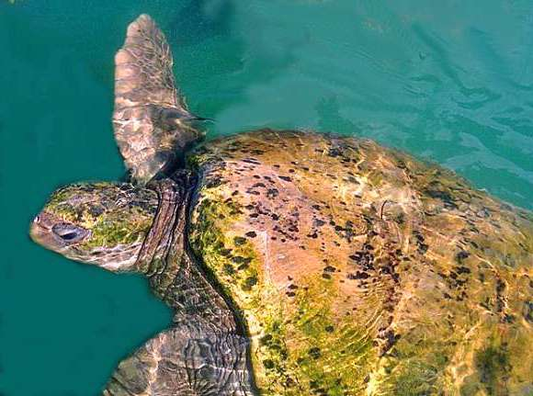
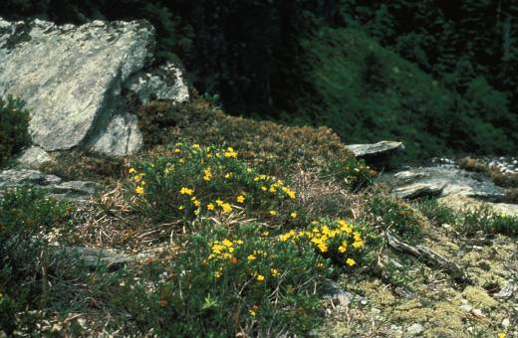
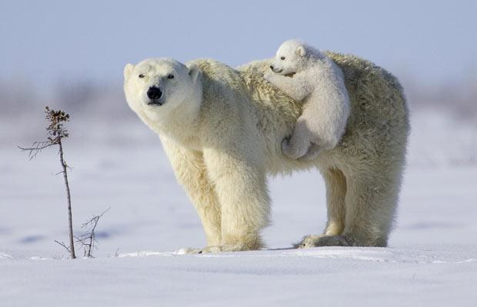
Stage structure and stochasticity

Slide 2
Without Environmental Stochasticity
Transition matrix:
Time t
e
h
j
s
a
e
0
0
0
4.7
61.9
h
0.68
0.70
0
0
0
Time t+1
0
0.05
0.66
0
0
j
s
0
0
0.02
0.68
0
a
0
0
0
0.06
0.81
Elasticity matrix:
e
h
j
s
a
e
0
0
0
0.01
0.05
h
0.06
0.16
0
0
0
j
0
0.06
0.13
0
0
s
0
0
0.06
0.15
0
a
0
0
0
0.05
0.27

Slide 3
Incorporating stochasticity into structured population models
You need structured population data for more than 2 years.
For example, with 4 years of data, you can have 3 matrices: A₁, A₂, A₃
Matrices can have unequal probabilities of occurring.

Slide 4
How would you project population size at time 50?

Slide 5
Stochastic matrix modeling
Input
-your matrices
-the probability of each matrix occurring (must add to one)
-the number of year to project into the future
-the number of replicate simulations you want to run
-the initial population size
Output
-the ending population size

Slide 6
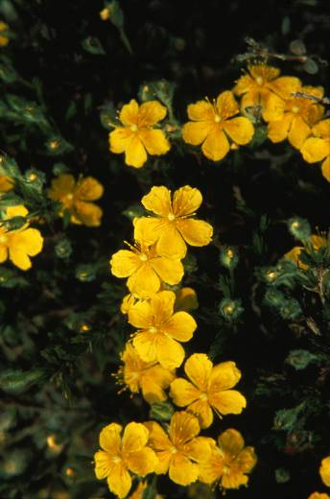
Hudsonia montana
(Mountain Golden Heather)
Threatened plant that lives on Table Rock Mountain in North Carolina

Slide 7
Life Cycle Graph
Seed
lings
Seeds
1
2
3
4

Slide 8
Cecil Frost data from 1985-1989
λ
A₈₅
0.96
A₈₆
1.01
A₈₇
0.84
A₈₈
1.02

Slide 9
Input: Golden mountain heather
If we assume each matrix is equally likely, each has a 0.25 probability of occurrence
Initial population size of 4343
Project 50 years into the future
5000 replicate simulations

Slide 10
Output: Golden mountain heather
Mean=663
Frequency
Population size after 50 years

Slide 11
Output: Golden mountain heather
QE threshold = 500

Slide 12
Temporal mosaic of environments
Stochastic sequence
Fixed sequence
time

Slide 13
Periodic Matrix Models
(for fixed sequences)
Phase 1 (matrix A₁)
Phase 4 (matrix A₄)
Phase 2 (matrix A₂)
Phase 3 (matrix A₃)

Slide 14
Examples of periodic environments

Slide 15
Disturbance mosaics
(treefall gaps, hurricanes, fires)
Each environmental state= one projection matrix
Environment transition matrix

Slide 16
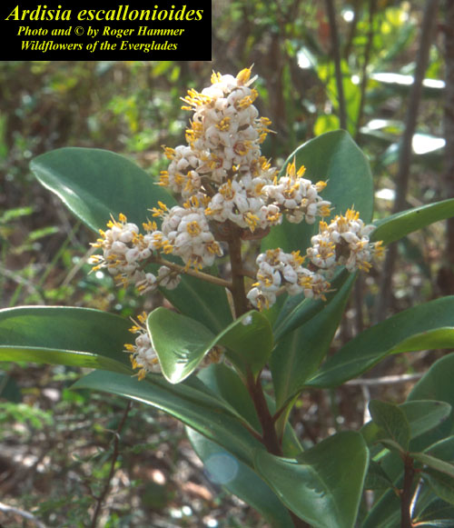
Hurricanes and the population dynamics of a Florida Shrub
John Pascarella and Carol Horvitz
University of Miami, Florida
Ecology 1998 vol 79, pp. 547-563

Slide 17
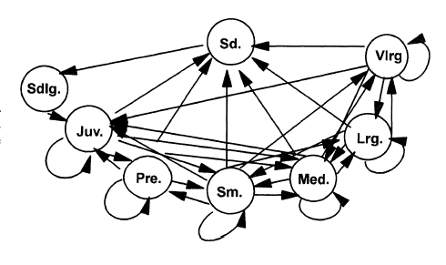
Ardesia Life Cycle

Slide 18
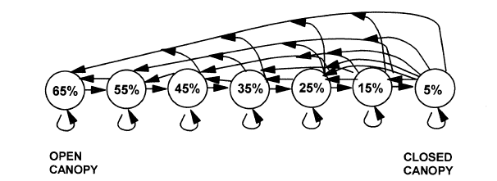
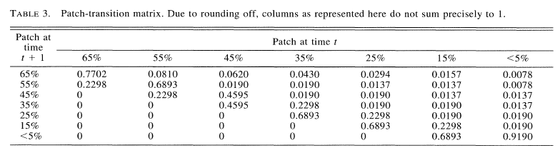
Environment transition matrix

Slide 19
Patch type and λ
2
λ
1.5
1
<5%
15%
25%
35%
45%
55%
65%
Patch Type

Slide 20
Hurricane frequency and λ
2
Historical hurricane frequency = 0.1
λ
1.5
1
0
0.2
0.4
0.6
0.8
Frequency of hurricanes

Slide 21
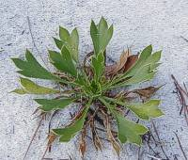
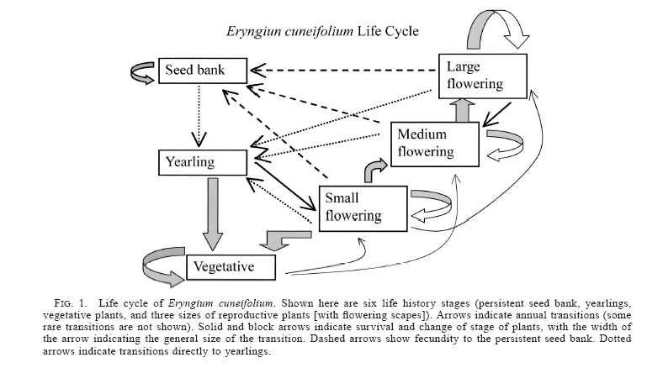
Fire
Menges and Quintana-Ascencio 2004

Slide 22
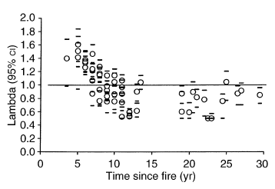

Slide 23
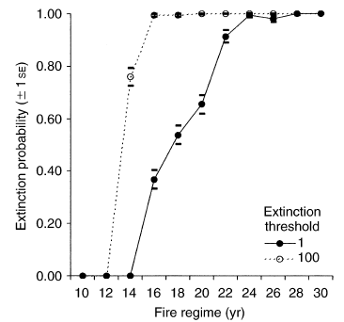

Slide 24
Polar Bears

Slide 25
Christine Hunter et al. 2010 Ecology
800 radio-collared bears

Slide 26
Polar bears depend on sea ice
Notes:
Polar bears depend on sea ice for access to their prey (ringed and bearded seals). In warm summers, there are fewer days with good ice conditions, and in extremely warm summers, the sea ice melts completely. Without sea ice, bears are forced to spend the summer on shore. During this time, they are largely food deprived, and rely on body fat accumulated during the previous years. Sometimes bears take longer movements over rougher sea ice and more open water. This leads to increased risk of injury or death, especially for cubs.

Slide 27
Polar bear demography- normal ice year
0.506
Juvenile
(2-years)
0.986
0.986
Juvenile
(4 years)
0.986
Juvenile
(3 years)
Adult
0.379
0.992
0.486
0.581
0.543
Adult with cub
Adult with yearling
0.068

Slide 28
What is the population growth rate?
Which vital rates is the population sensitive to changes in?

Slide 29
Polar bear demography- bad ice year

Slide 30
What is the population growth rate in a bad ice year?
Which vital rates change between the normal ice year and the bad ice year?
Which parameters in the matrix population model do you think are most responsible for the different in population growth rate observed in good vs. poor ice years and why?

Slide 31
Project the population size of polar bears 50 years in the future under three conditions:
historic frequencies of poor sea ice years (0.21)
current frequencies of poor sea ice years (0.40)
future (year = 2100) frequencies of poor sea ice years based on IPCC climate models (0.80).
The initial population size of polar bears is 1085, specifically in the following stage classes:
juveniles-2year= 106
juveniles-3year=68
juveniles-4year= 106
adult= 461
adult with cub= 151
adult with yearling=108

